Slide 1

Getting Started
Lesson 1

Slide 2
What the Lesson Will Cover
Introduction to the course
Theory and project lessons
Success criteria
Gracious professionalism
Micro:python
Text based vs blocks
Syntax
Notes:
Introduce the lesson and what it will cover, Learners could discuss or ask question about what the lesson might involve.

Slide 3
Theory lessons and project
Theory lessons
Projects
Learning about core theory
Covers computational techniques
Includes activities with success criteria
Typically done individually
Group tasks (typically groups of 4)
Requires teamwork and communication
Must work in parallel
Clear success criteria for both software and hardware
Typically involves designing and building a product to solve a problem

Slide 4
Success criteria
These are the key objectives for the lesson/project
You need to plan your time to meet these criteria
Use these to check progress

Slide 5
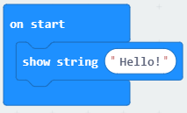
Blocks to code
=
from microbit import *
display.scroll("Hello!")

Slide 6
Indentation for formatting
from microbit import *
boat = Image("09090:"
"09090:"
"09090:"
"99999:"
"09990")
display.show(boat)
or
boat = Image("09090:""09090:" "09090:" "99999:" "09990")

Slide 7
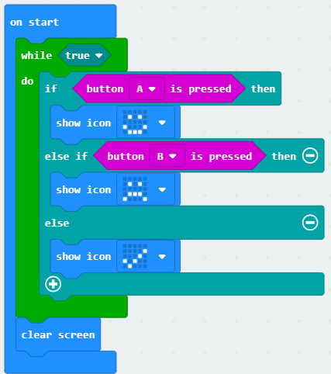
Indentation
from microbit import *
while True:
if button_a.is_pressed():
display.show(Image.HAPPY)
elif button_b.is_pressed():
display.show(Image.SAD)
else: display.show(Image.YES)
display.clear()
=

Slide 8
Case sensitivity and special characters
Microbit, microbit and microBit are all different things!
If you get a ‘NameError’ then you have mistyped something.
‘,” and : are all special characters, ensure you haven’t added them by mistake or have missed them where they are needed
Be careful with full stops (.) as these will confuse Python if you use them inappropriately

Slide 9
Troubleshooting
Python needs you to type in the code perfectly
It will display error messages and try to tell you what line the error is on (this isn’t always right!)
If you get a SyntaxError then you have typed something that Python doesn’t understand
If the micro:bit freezes – turn it off and on again (power cycle)

Slide 10
Success criteria
Look at the Python code and match it to the blocks version
Find out why Indentation is important
Find out what case sensitivity is
Find online the Python syntax for the code block examples
Notes:
Learners work through the activity sheet

